Slide 1

DATA ANALYZER
Team Id: 22_AI_2A_15
Aakarshit Srivastava (2101641520001)
Dev Gupta (2101641520046)
Shashak Raj Singh (2101641520128)

Slide 2
Table of Contents
Project Objective
Feasibility Study (technical feasibility, operational feasibility, economic feasibility, schedule feasibility and legal feasibility.)
Methodology(Architecture diagram/ DFD’s/ER Diagram/Class Diagram/Flow Chart.)
Tools/Technology Uses (Technologies/Platform/APIs to be used.)
Role of team members in the project and their expertise areas.
References

Slide 3
Project Objective
The end product will be a SaaS i.e. Software as a service. Plus after 2020 India is also in the phase of adapting to SaaS market.
A intuitive Webpage that will be accessed by the user for the inputs and the user satisfactory output will be given according to the trained algorithms.
A graphical menu driven front end and model trained on datasets for backend.
The Application will help the end user with staying updated with his requirements and work according without any extra effort and may even become a type of morning habit.
The project can help many startups and businesses to grow and gain customers effectively.
The milestone for the project will be to become a global phenomenon and gain as many users as possible from a 12 year old child to a 75 year old retired person.
Team_Id: 22_AI_2A_15

Slide 4
Feasibility Study
This project aims to utilize the data as a resource to generate predictions using the artificial engines and mechanisms. The project will provide solutions to many problems and enhance strategies and an overall information requirement of the user with satisfactory results.Data being the immediate need of the today’s world the product/service will be very optimal and will result in a very successful venture
Team_Id: 22_AI_2A_15

Slide 5
Economic Feasibilty : As the indian market will be growing in technology the demand and value of data will increase. The process is reliable and can be used for passive income.
Technical Feasibilty : The service will be completely client server based with frequent need of updation and may need upgradation.With user end requirement of a stable internet connection.
Operational Feasibility : The service will be very effective in fulfilling user’s need of information and validation of information.
Schedule Feasibilty : The service is very compatible and light to develop and optimization of the resources is also very simple and an easy task.
Legal Feasibilty : The data and services utilized are all legal and zoned without any illegitimate data collection or theft
Team_Id: 22_AI_2A_15

Slide 6
Methodology
The project Data Analyzer is simply a machine learning based model that is being fed with upto date data and the trained algorithm is expected to predict outcomes, more the data input and regularization more will be the efficiency of the model. The trained model will then be connected and synced up with a web app builder called anvil that will be used to make a user interface or front end of the web service.
Team_Id: 22_AI_2A_15

Slide 7
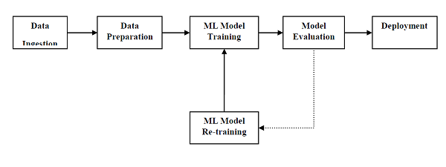
figure 1. model training diagram
Language used for project development is python with the environment of Jupyter which is a notebook, JupyterLab is the latest web-based interactive development environment for notebooks, code, and data. Its flexible interface allows users to configure and arrange workflows in data science, scientific computing, computational journalism, and machine learning.
Team_Id: 22_AI_2A_15

Slide 8

Jupyter notebooks basically provides an interactive computational environment for developing Python based Data Science applications. They are formerly known as ipython notebooks. The following are some of the features of Jupyter notebooks that makes it one of the best components of Python ML ecosystem.Jupyter notebooks can illustrate the analysis process step by step by arranging the stuff like code, images, text, output etc. in a step by step manner.It helps a data scientist to document the thought process while developing the analysis process.One can also capture the result as the part of the notebook.With the help of jupyter notebooks, we can share our work with a peer also
Team_Id: 22_AI_2A_15

Slide 9
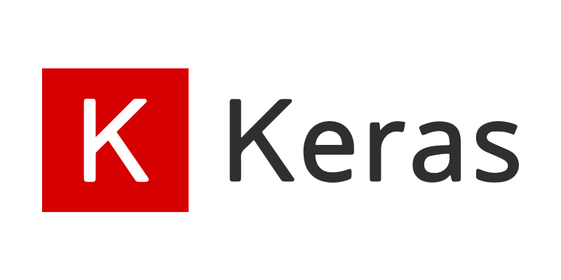
Keras is a high-level API for building and training deep learning models.TFKeras is TensorFlow’s implementation of this API. Keras is an open-source software library that provides a Python interface for artificial neural networks. Keras acts as an interface for the TensorFlow library. Up until version 2.3, Keras supported multiple backends, including TensorFlow, Microsoft Cognitive Toolkit, Theano, and PlaidML.
Team_Id: 22_AI_2A_15

Slide 10

Kaggle is an online community platform for data scientists and machine learning enthusiasts. Kaggle allows users to collaborate with other users, find and publish datasets, use GPU integrated notebooks, and compete with other data scientists to solve data science challenges. The aim of this online platform is to help professionals and learners reach their goals in their data science journey with the powerful tools and resources it provides. As of today (2021), there are over 8 million registered users on Kaggle.
One of the sub-platforms that made Kaggle such a popular resource is their competitions. In a similar way that HackerRank plays that role for software developers and computer engineers,Kaggle has significant importance for data scientists
Team_Id: 22_AI_2A_15

Slide 11
With the help of kaggle, we will obtain as many datasets as we require without any fear of data cleaning. Data cleaning is the process of fixing or removing incorrect, corrupted, incorrectly formatted, duplicate, or incomplete data within a dataset. When combining multiple data sources, there are many opportunities for data to be duplicated or mislabeled.
Team_Id: 22_AI_2A_15

Slide 12
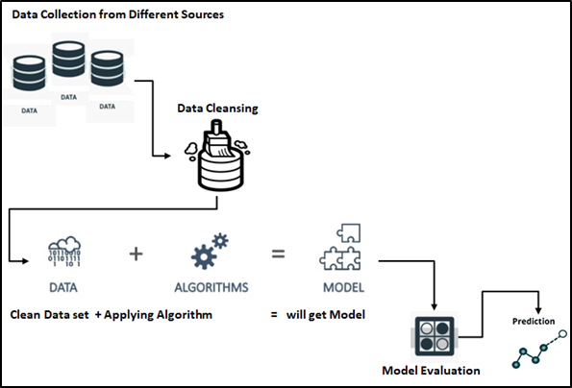
figure 2:working of machine learning model
Team_Id: 22_AI_2A_15

Slide 13
Model Training
A training model is a dataset that is used to train an ML algorithm. It consists of the sample output data and the corresponding sets of input data that have an influence on the output. The training model is used to run the input data through the algorithm to correlate the processed output against the sample output. The result from this correlation is used to modify the model. This iterative process is called “model fitting”. The accuracy of the training dataset or the validation dataset is critical for the precision of the model. Model training in machine language is the process of feeding an ML algorithm with data to help identify and learn good values for all attributes involved.
Team_Id: 22_AI_2A_15

Slide 14
There are several types of machine learning models, of which the most common ones are supervised and unsupervised learning. Supervised learning is possible when the training data contains both the input and output values. Each set of data that has the inputs and the expected output is called a supervisory signal. The training is done based on the deviation of the processed result from the documented result when the inputs are fed into the model. Unsupervised learning involves determining patterns in the data. Additional data is then used to fit patterns or clusters. This is also an iterative process that improves the accuracy based on the correlation to the expected patterns or clusters. There is no reference output dataset in this method.
Team_Id: 22_AI_2A_15

Slide 15
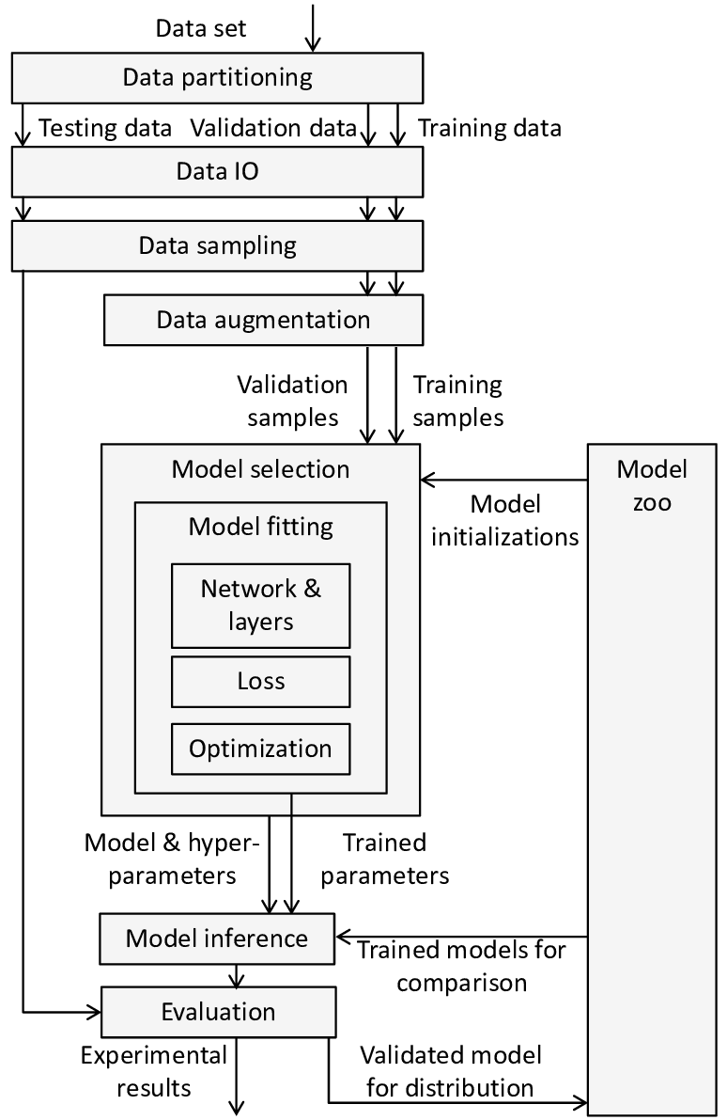
Team_Id: 22_AI_2A_15

Slide 16
Preparing the Data
The data preparation stage is when data is profiled, formatted and structured as needed to make it ready for training the model. This is the stage where the appropriate characteristics and attributes of data are selected. This stage is likely to have a direct impact on the execution time and results. This is also at the stage where data is categorized into two groups – one for training the ML model and the other for evaluating the model. Pre-processing of data by normalizing, eliminating duplicates and making error corrections is also carried out at this stage.
Team_Id: 22_AI_2A_15

Slide 17
Preparing a neural network
Artificial neural networks are inspired by the biological neurons within the human body which activate under certain circumstances resulting in a related action performed by the body in response. Artificial neural nets consist of various layers of interconnected artificial neurons powered by activation functions that help in switching them ON/OFF. Like traditional machine learning, here too, there are certain values that neural nets learn in the training phase.
Team_Id: 22_AI_2A_15

Slide 18

Web Application
Last and final step will be to create a user interface, and also a site that can be accessed globally and 247, for which I found a free web app builder anvil works, that is also a python based service. Anvil is a platform for building full-stack web apps with nothing but Python. No need to wrestle with JS, HTML, CSS, Python, SQL and all their frameworks.We can just pip install it and connect our code with the uplink and create a web appication
Team_Id: 22_AI_2A_15

Slide 19
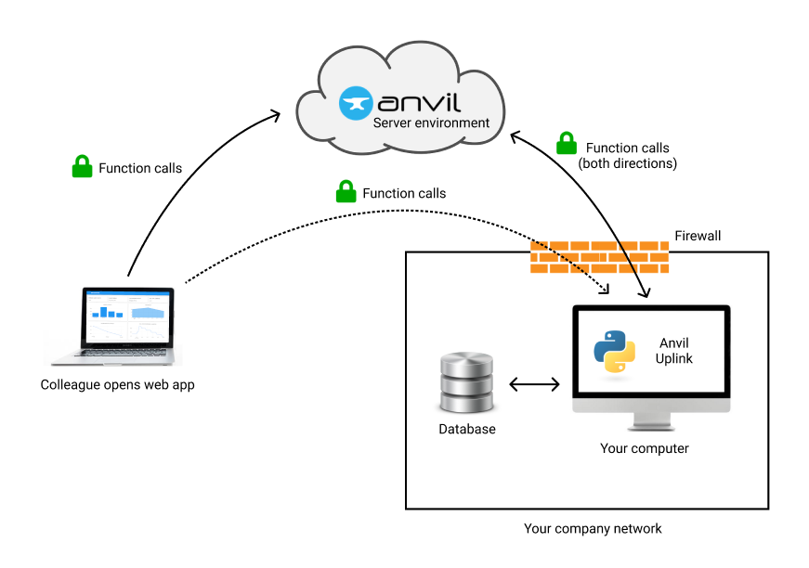
A link will be generated by anvil services which can access the project by anyone with the link and utilized, with proper and validated data we can publish the project and add some revenue options for some earnings to donation funds.
Team_Id: 22_AI_2A_15

Slide 20
Tools &Technology Used:
Hardware Requirements
64 bit, 4 core, with minimum 3.0 Ghz each core clock frequency will be needed,8+ core is recommended for larger datasets
16 Gb RAM is recommended for efficient working
Cloud computing services
Software Requirements
OS: Windows 10/11
Language: Python 3.10 or 3.9
IDE: Visual Studio Code extension Jupyter Notebook or browser app
Plugins: Tensorflow, Streamlit, Anvil + webservices
Team_Id: 22_AI_2A_15

Slide 21
References
Infosys Springboard Deep learning and regression analysis https://infyspringboard.onwingspan.com
Udemy Web Development course
Udemy Python Bootcamp 2022
Deep Learning for developers
Kaggle Intro to Machine Learning
YouTube tutorials and lectures
(https://www.youtube.com/playlist?list=PLb0Z48JmZ1a-YhddZaIpp1YHuXejD-alz)
Team_Id: 22_AI_2A_15

Slide 22
Role of Team Members
Aakarshit Srivastava
Project leader and manager
Worked on backend algorithm and frontend design
Designed neural network s for various functions using python
Team_Id: 22_AI_2A_15

